Slide 1
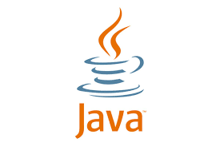

Introduction to java
Code For Coders

Slide 2
We're going to cover the basics of Java programming and give you a quick overview of what is Java, where it’s used and why it's important.
Topics

Slide 3
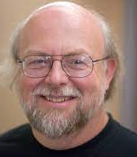
History of java
James gosling introduce java in June
1991 as a project called oak.
The first version of java (java 1.0) is release
in 1991.
The first name of java is oak.
Java is the name of coffee seed.

Slide 4
What is java & Where it is used?
Java is a programming language(High level language)that was first introduced by Sun Microsystems in 1995.
It's a popular language used for developing a wide range of applications, from mobile apps to desktop software, web applications, and even enterprise-level systems.

Slide 5
why javA ?
One of the key reasons Java is so widely used is that it's platform-independent. This means that Java programs can run on any device that has a Java Virtual Machine (JVM) installed, regardless of the underlying operating system.
Another reason for Java's popularity is its scalability. It's a language that's suitable for building both small and large-scale applications, and it's designed to be highly adaptable to different programming environments and architectures.

Slide 6
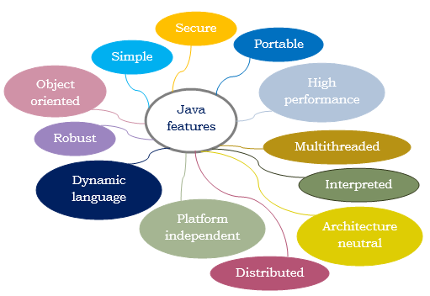
Features of java

Slide 7
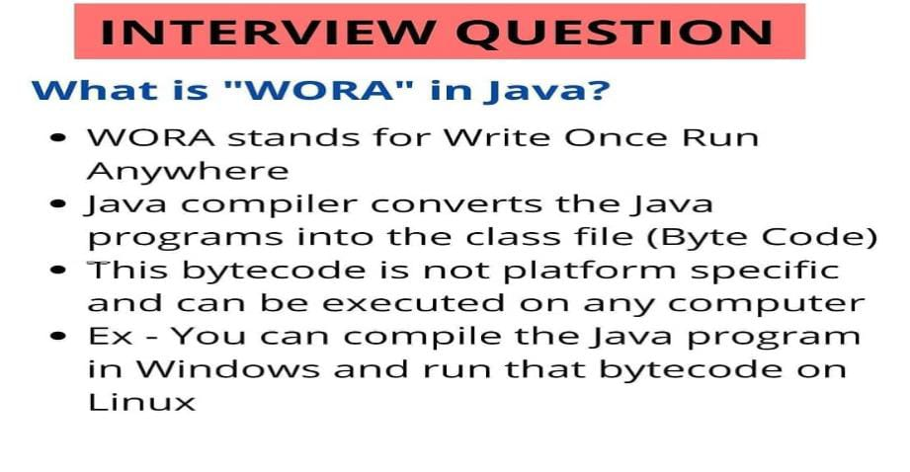

Slide 8
